Slide 1
Simple Application Testing Lite Tool (SATLite)
-suvigya tripathi

Slide 2
OBJECTIVE
This Simple Application Testing Lite tool (SATLite tool) is developed with an objective to test run-time errors and exceptions which occurs during the execution of scientific tools (Amber, Coco etc) on remote supercomputers
Errors and exceptions might occur due to following reasons:
Improper or obsolete module loading
Improper input arguments or input files
System failure or segmentation fault
Notes:
<number>

Slide 3
FEW TERMS
Few words related to the SATLite tool and remote supercomputer :
Modules: Basic environment for the default compilers, tools, and libraries. Users requiring 3rd party libraries or tools can tailor their environment with the applications and tools they need.
Files : User's input files specific for the scientific tool
Notes:
<number>

Slide 4
IMPLEMENTATION
Currently SATLite tool reports following errors:
Improper module loading
Improper input files and arguments
System failures
Execution errors
Current Remote Machine:
The current version of tool is tested on STAMPEDE.
Supported SLURM scheduler

Slide 5
DESIGN
Remote resource config file
Scientific Tool specific default modules file
User attributes
Scientific Tool name
SATLite Tool
Module Test Result
Remote resource
Input arguments and files
Execution Test Result
Executable and User Modules (optional)
Notes:
<number>

Slide 6
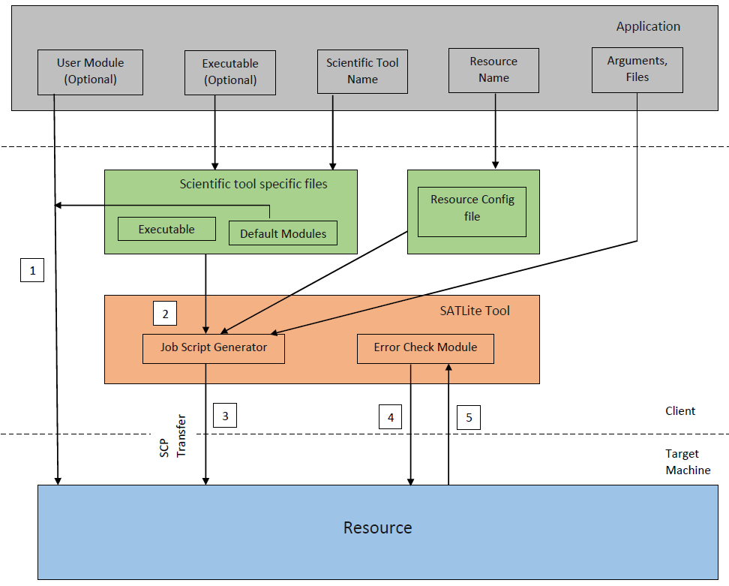
ARCHITECTURE
Control Flow
Module Test:
Load user provided/default module on supercomputer and check for error
Execution Test:
Generate SLURM script using executable, modules and resource configs
Transfer input files and SLURM script to remote machine and launch job script
Check for any error trigger
Report back error if any
Notes:
<number>

Slide 7
ABSTRACTION OF TOOL
Notes:
<number>

Slide 8
SATLite API
Function name | Arguments | Description
set_attribute | name, resource, arguments, exe (optional), modules(optional) | Sets required attributes
run | void | Executes test
Notes:
<number>

Slide 9
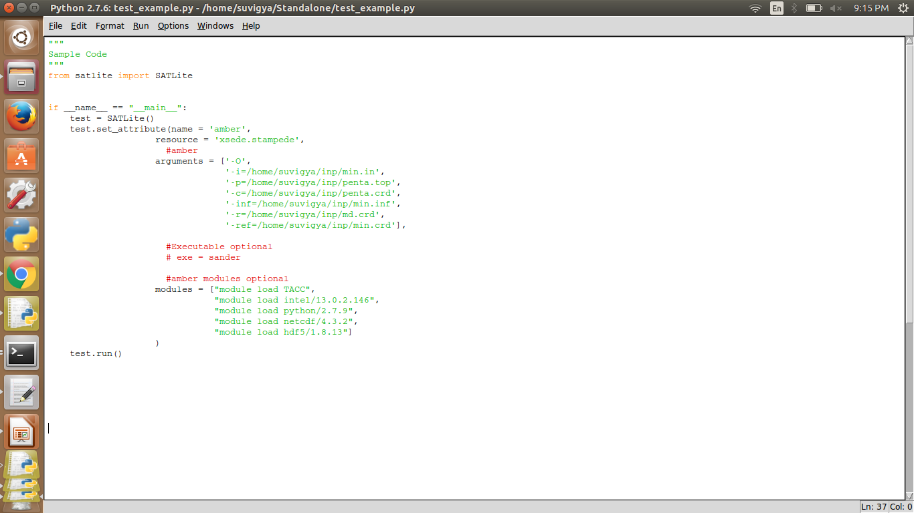
Sample Code
Notes:
<number>

Slide 10
SAMPLE OUTPUT
Notes:
<number>

Slide 11
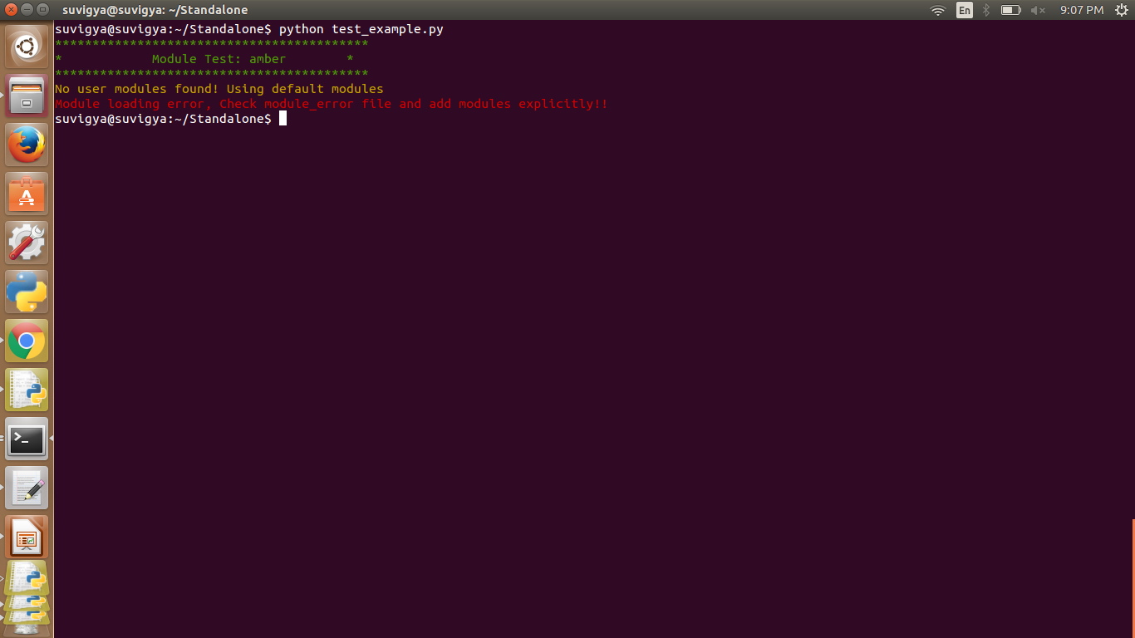
Failure Output
Notes:
<number>

Slide 12
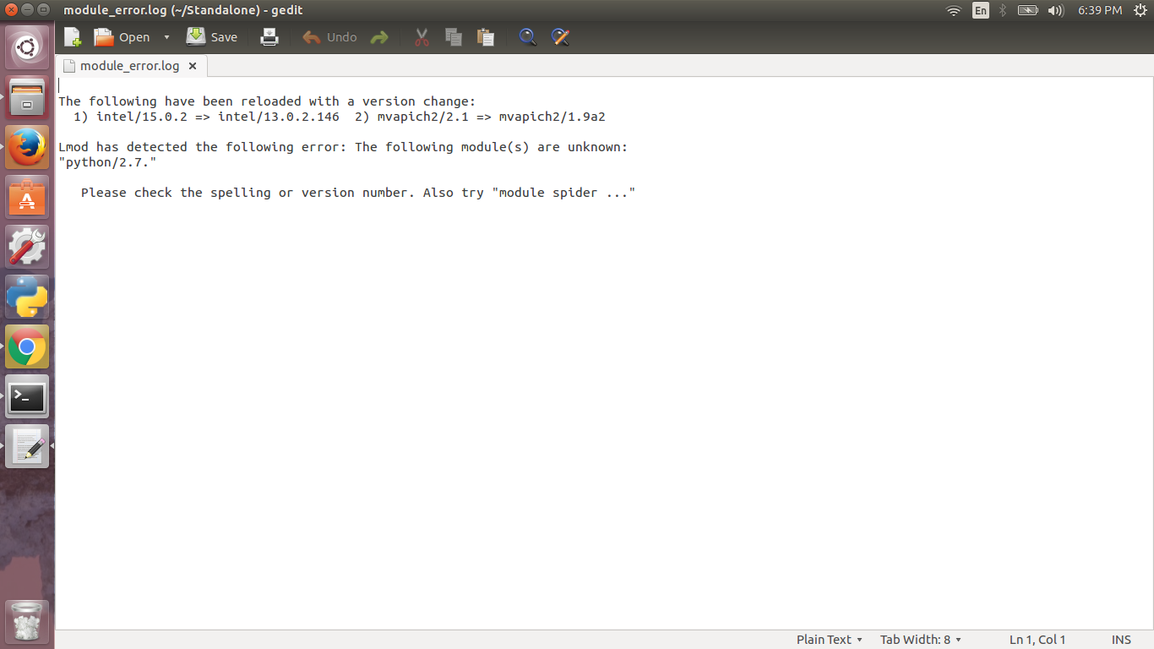
Error Reporting

Slide 13
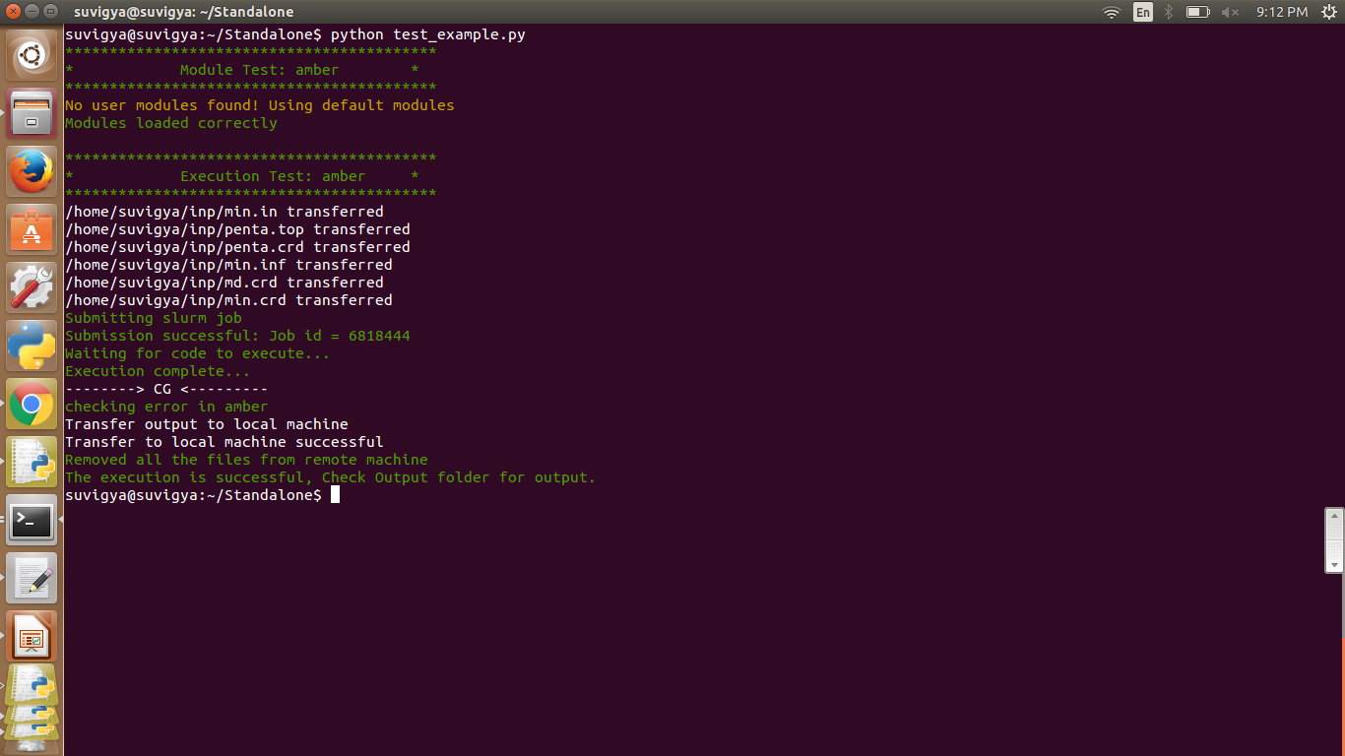
Successful Execution
Notes:
<number>

Slide 14
FUTURE WORK
SAGA-based implementation
Testing on other remote Supercomputers:
Archer
Blue Waters
Target Job Script:
PBS
Error Detection and Reporting:
Currently report errors based on execution failure
Error detection can be enhanced if execution is successful but improper output generated (based on execution time)

Slide 15
SOURCE CODE
Github:
https://github.com/suvigya91/SATLite.git
Notes:
<number>

Slide 16
QUESTIONS
Notes:
<number>

Slide 17
SUGGESTIONS / FEEDBACK
Notes:
<number>

Slide 18
THANK YOU
Notes:
<number>

